Slide 1
Lesson 25
Network Fundamentals
Computer Literacy BASICS: A Comprehensive Guide to IC³, 4th Edition
Morrison / Wells

Slide 2
Objectives
Describe a network.
Identify the benefits of a network.
Evaluate the risks of network computing.
Identify client/server networks.
Identify network types.
Understand network communications.
Resolve network security issues.
2
2

Slide 3
Vocabulary
biometric security measure
cable modem
client
client/server network
communications channels
digital subscriber line (DSL)
extranet
firewall
hacker
hub
Internet
3
3

Slide 4
Vocabulary (continued)
intranet
local area network (LAN)
modem
node
peer-to-peer (P2P) network
proxy server
Public Switched Telephone Network (PSTN)
router
server
server operating system
4
4

Slide 5
Vocabulary (continued)
T-1 line
wide area network (WAN)
WiMAX
wireless Internet service provider
(WISP)
wireless LAN (WLAN)
5
5

Slide 6
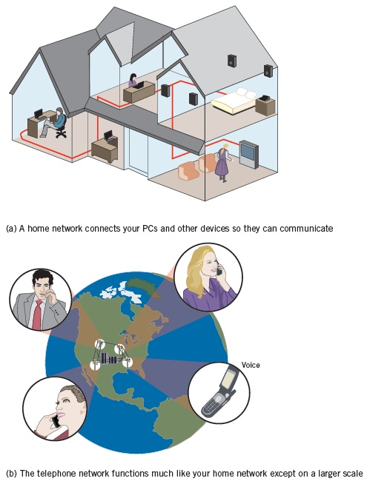
Introducing Networks
A network is simply a group of two or more computers linked together.
Digital, mobile, and standard telephones are supported through the Public Switched Telephone Network (PSTN).
6
6

Slide 7
Identifying the Benefits of a Network
A network like the Internet provides instant communication. Other benefits include:
  Information sharing
  Collaborative environment
  Hardware sharing
  Software sharing
  Enhanced communication
7
7

Slide 8
Evaluating the Risks of Networked
Computing
The security of a computer network is challenged every day by equipment malfunctions, system failures, computer hackers, and virus attacks.
Equipment malfunctions and system failures can be caused by natural disasters such as floods or storms, fires, and electrical disturbances such as brownouts or blackouts.
8
8

Slide 9
Evaluating the Risks of Networked
Computing (continued)
Other disadvantages of networks include:
  Individual loss of autonomy
  Malicious code
  Network faults
  Setup and management costs
  Lack of privacy
9
9

Slide 10
Identifying Client/Server Networks
The term client/server network describes a network design model.
In most instances, the client is a software program such as Internet Explorer.
The server is hardware (a computer) and can be one of many types, such as a mail server, a database server, an FTP server, an application server, or a Web server.
Server operating systems are high-end programs designed to provide network control and include special functions for connecting computers and other devices into a network.
10
10

Slide 11
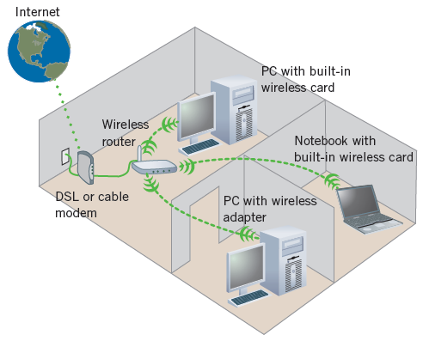
Identifying Network Types
Local Area Networks:
Most LANs connect personal computers, workstations, and other devices such as printers and scanners in a limited geographical area, such as an office building, school, or home.
11
11

Slide 12
Identifying Network Types (continued)
Wide Area Networks (WAN):
A WAN covers a large geographical area and can contain communication links across metropolitan, regional, or national boundaries.
Other Types of Networks
  Client/server network
  Peer-to-peer network
  Intranet
  Extranet
  Internet
12
12

Slide 13
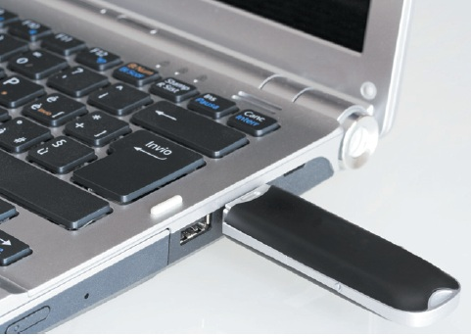
Understanding Network Communications
Communication Hardware:
  Modem
  Cable modem
  Digital subscriber line
  T-1 line
  Wireless
13
13

Slide 14
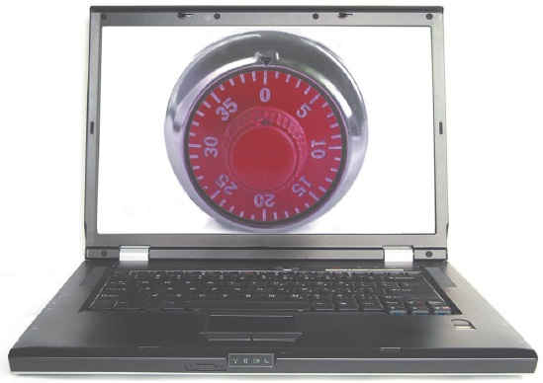
Resolving Network Security Issues
The most common form of restricting access to data is the use of passwords, which are similar to combinations you need to remove a lock.
14
14

Slide 15
Resolving Network Security Issues (continued)
Other security measures include:
  Electronic identification cards
  Firewalls
  Antivirus software
  Proxy server
Planning for Security:
Guidelines include:
  Selective hiring process
  Regular data backup
  Biometric security measures
15
15

Slide 16
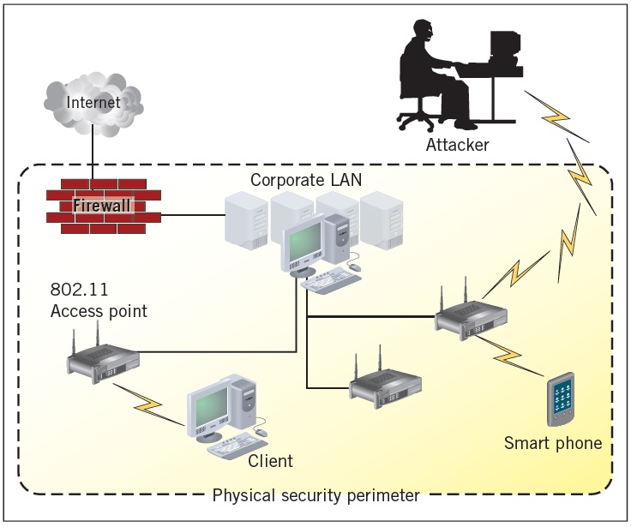
Resolving Network Security Issues (continued)
Wireless Security:
Wireless networking has many security issues and hackers have found it easy to access wireless networks.
16
16

Slide 17
Summary
In this lesson, you learned:
A network is a group of two or more computers linked together.
A telephone network is similar in makeup to a computer network. The Public Switched Telephone Network (PSTN) supports telephone service, and it is the world’s largest collection of interconnected commercial and government-owned voice-oriented systems.
17
17

Slide 18
Summary (continued)
You can use a network for information sharing, hardware sharing, software sharing, and as a collaborative environment.
Networks are categorized according to size as local area networks (LANs) and wide area networks (WANs).
LANs connect personal computers, workstations, and other devices such as printers and scanners in a limited geographical area, such as an office building, a school, or a home.
18
18

Slide 19
Summary (continued)
A WAN is made up of several connected local area networks.
In a client/server network, one or more computers on the network acts as a server. The server manages network resources. In a peer-to-peer (P2P) network, all of the computers are equal. No computer is designated as the server. People on the network each determine what files on their computer they share with others on the network.
19
19

Slide 20
Summary (continued)
Data insecurity is a risk with many networks. Some risks to computers are natural causes, some are accidents, and others are intentional.
The best way to protect data is to effectively control the access to it. Generally, this protection is the responsibility of the network administrators and security personnel. If unauthorized persons gain access to data, they may obtain valuable information or trade secrets. Hackers are people who break into computer systems to steal services and information.
20
20

Slide 21
Summary (continued)
Transmission media can be either physical or wireless.
A modem is a type of communications device. A hub is a device that controls the incoming and forwarding of data. A router directs traffic on the Internet or on multiple connected networks.
21
21

